Slide 1
AUTOMATED NEWS CATEGORIZATION SYSTEM
Gayathry S Kumar
MCA S3-A
Roll No:51

Slide 2
Description
Sentiment analysis is a process that studies the sentiments. The influence of sentiment analysis has penetrated business and even social media nowadays. Due to rapid development of social media, everyone can express their opinions on the internet. Hence the sentiment analysis plays a vital role in understanding what reviewers think.
News is one of the integral part of our social domain. The existing system consists of news gathered from different sources. It is quite difficult to categorize the news, with respective of the headline that it denotes. The proposed system classifies the news content into the categories and the model uses machine learning algorithms to categorize the news. The categorized news are stored and generate keyword.

Slide 3
Objective of study
The main objective is to create a model to predict the sentimental reviews according to the reports.
To determine whether the sentimental reviews is positive or negative.
To generate keywords according to the headlines description using deep learning. In this case, stopwords(is, was, on etc.) are removed.

Slide 4
Modules
1. Admin Activities
Add datasets
View user details
View posts and reviews
2. Reporter Activities
Add user details
Add reports
3. Guest User Activities
View posts
Add reviews
Predict the sentiment analysis

Slide 5
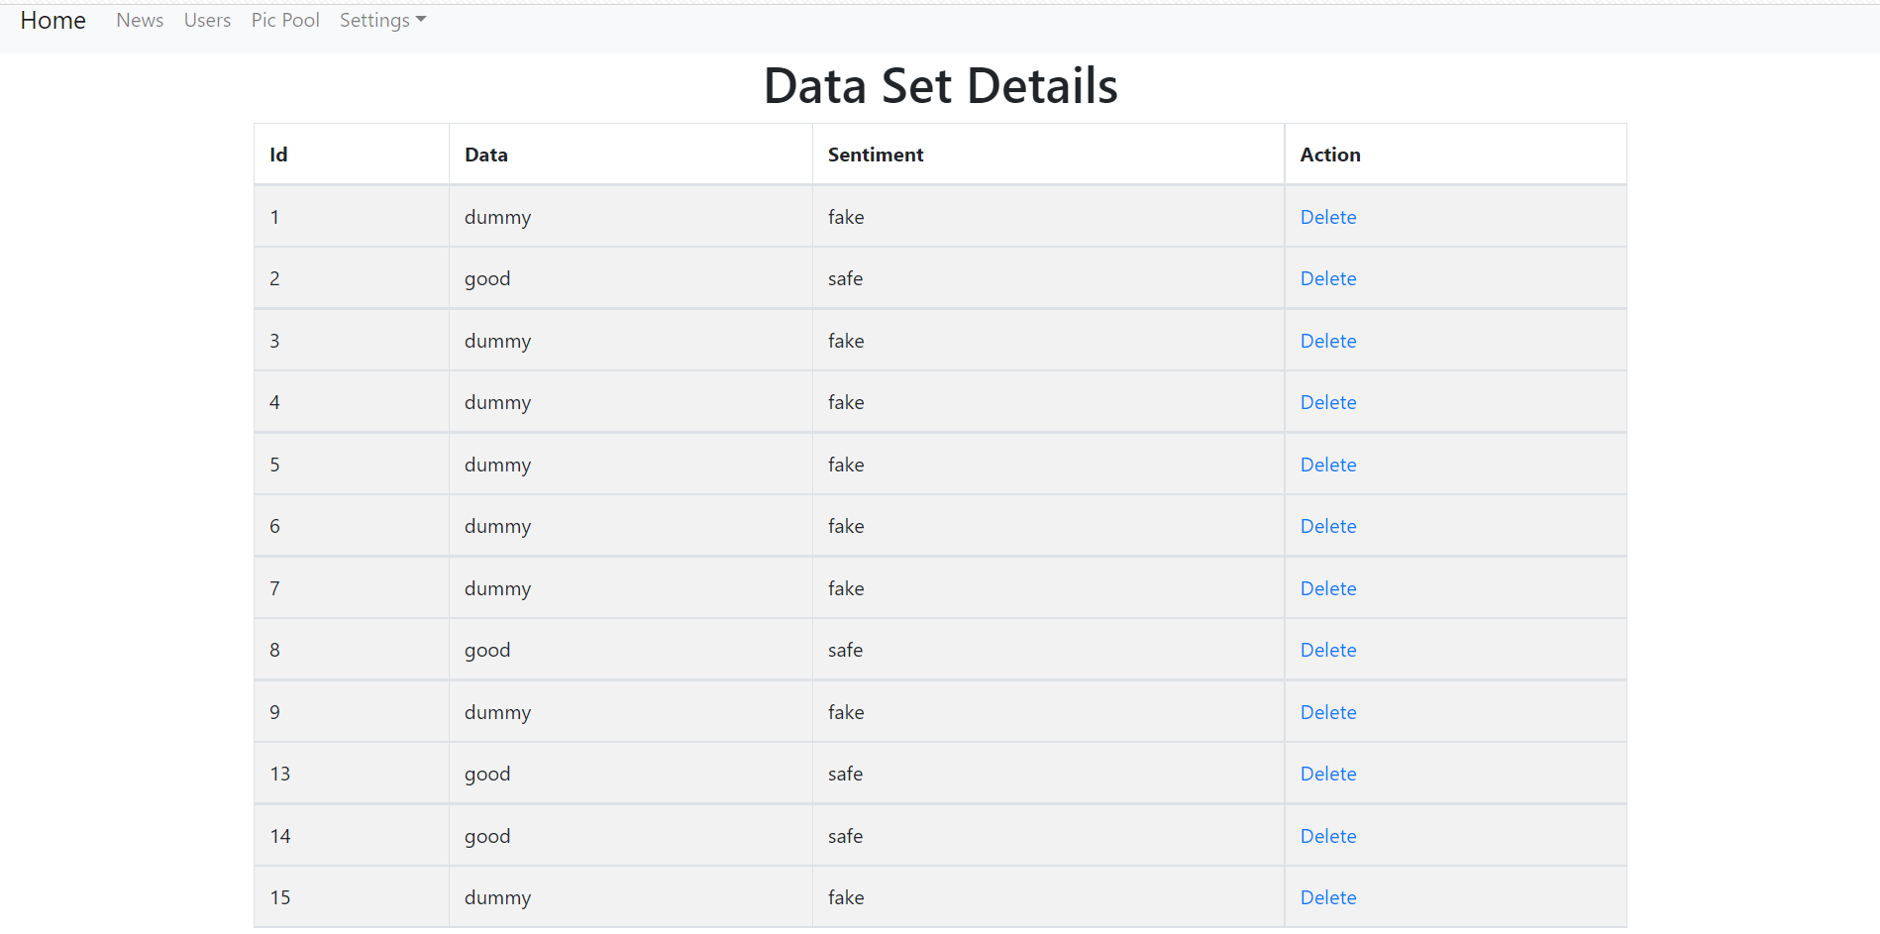
1. Admin Activities - Add dataset

Slide 6
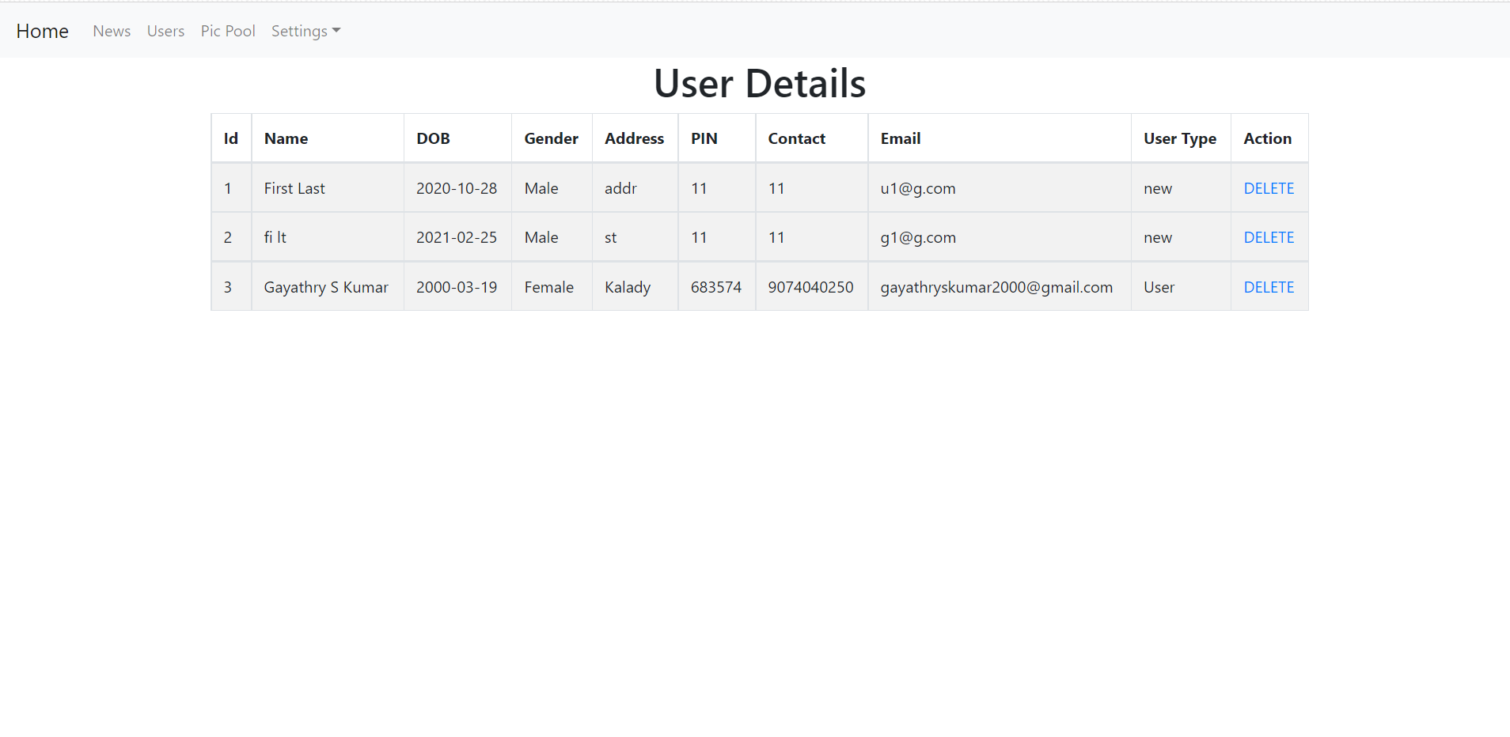
1. Admin Activities - View user details

Slide 7
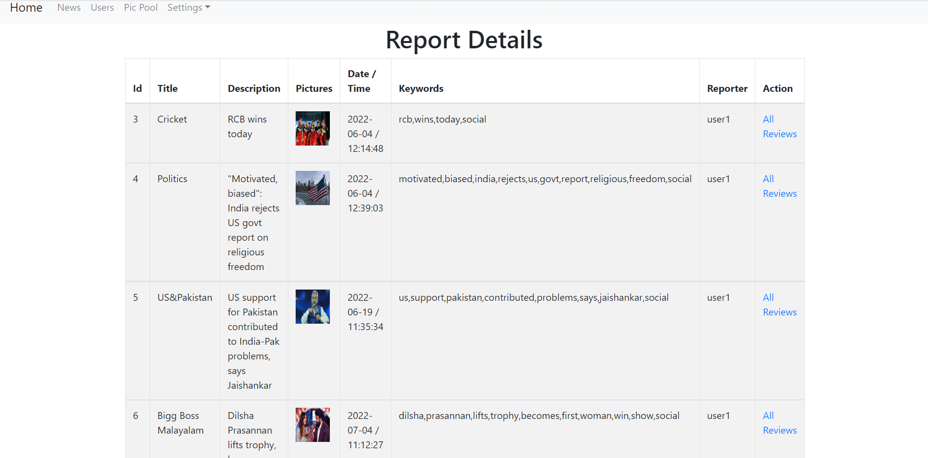
1. Admin Activities - View posts and reviews

Slide 8
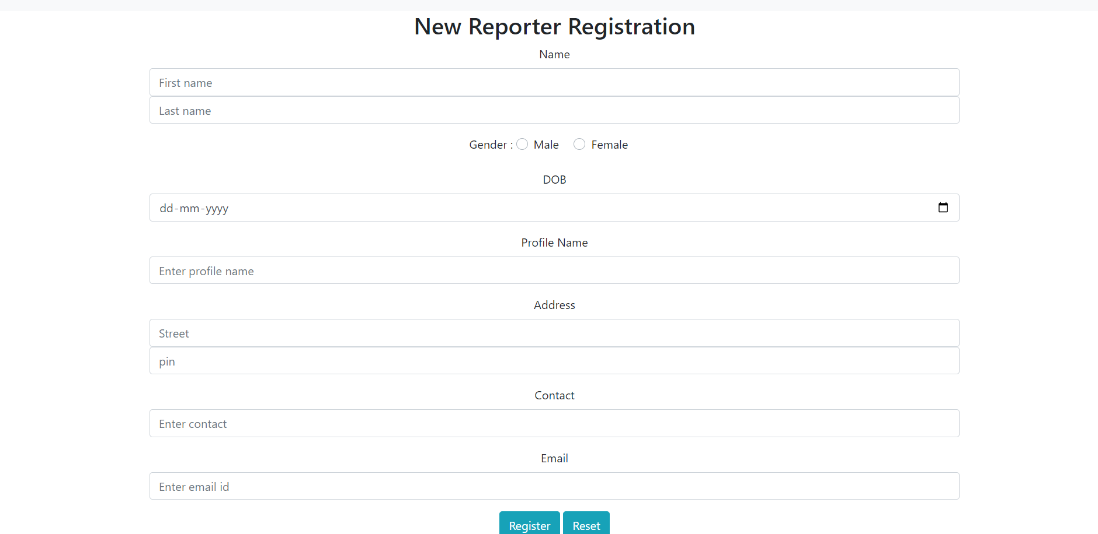
2. Reporter Activities - Add user details

Slide 9
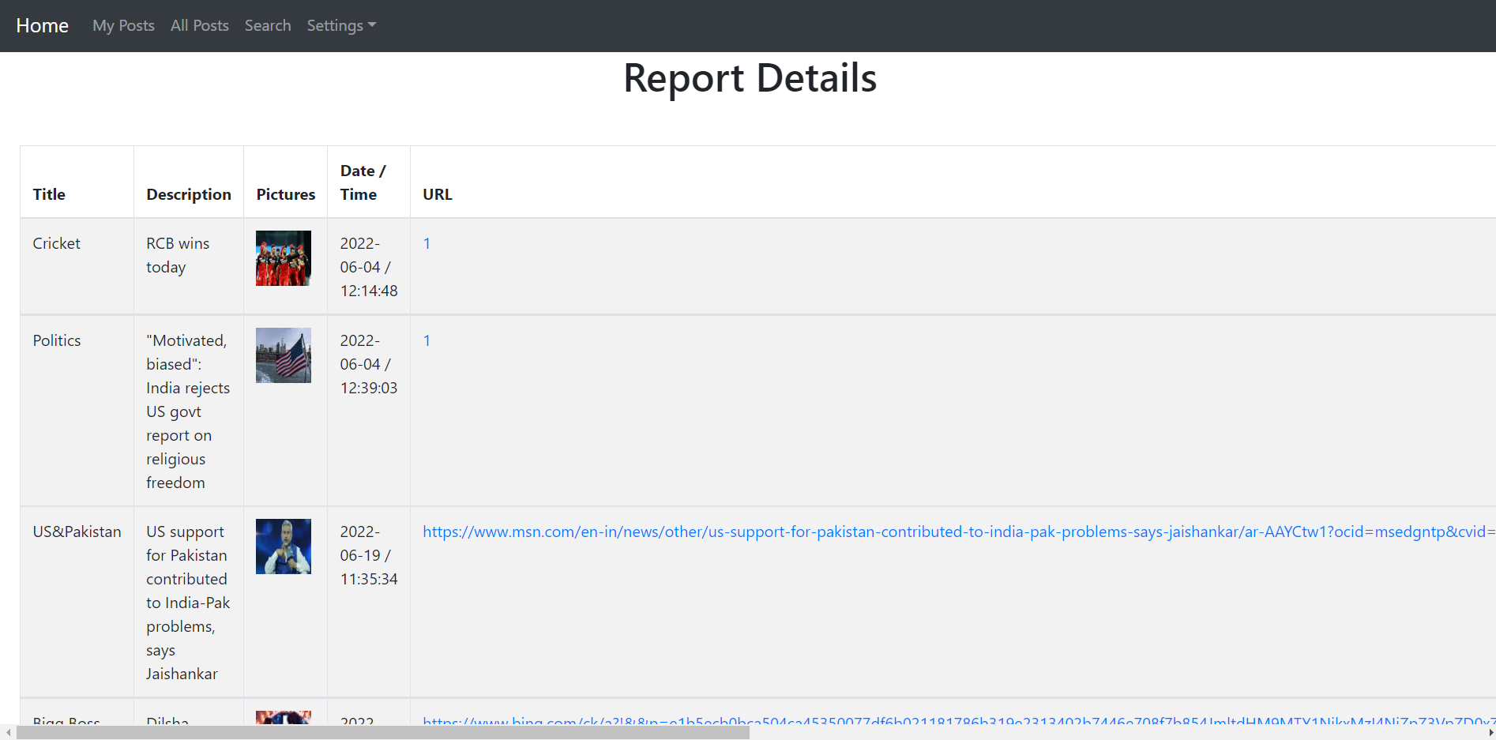
2. Reporter Activities - Add reports

Slide 10
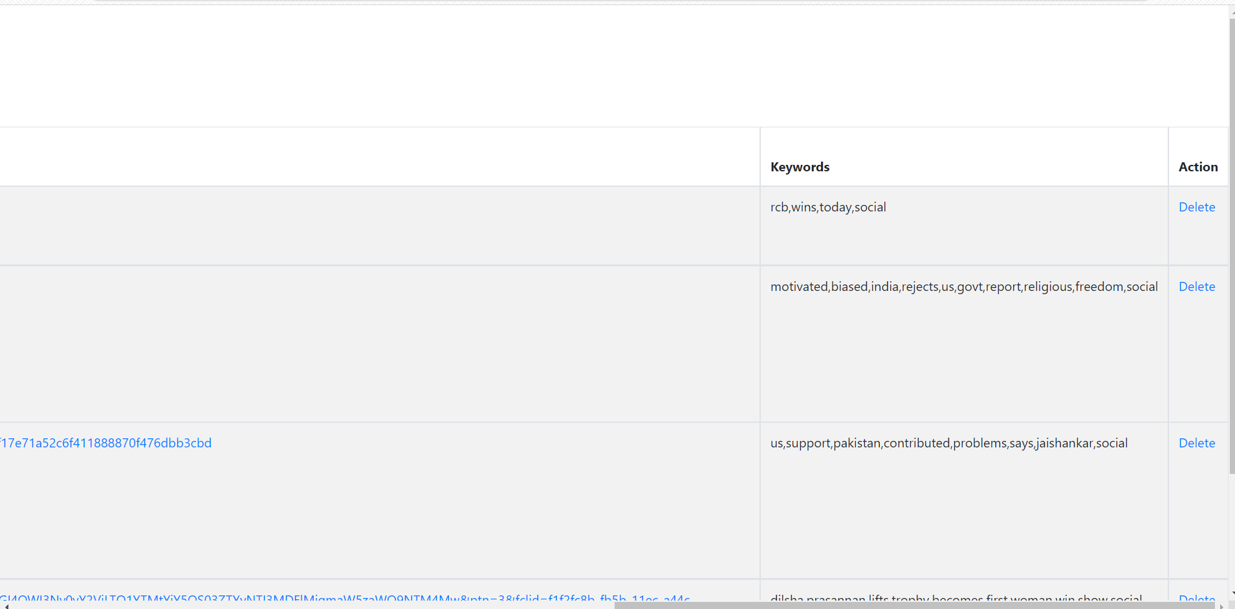

Slide 11
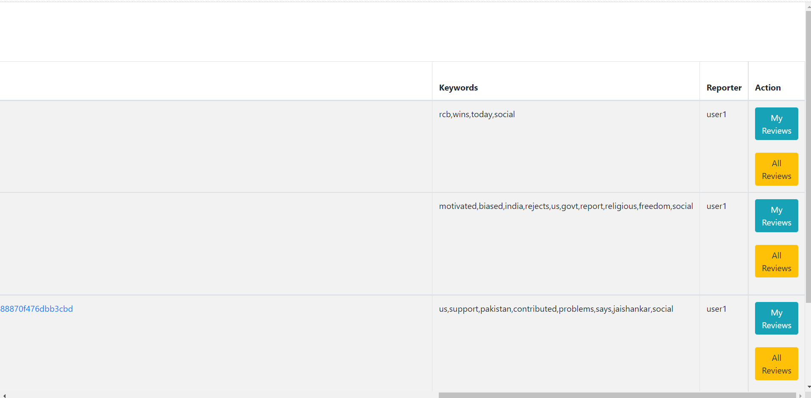
3. Guest User Activities - Add reviews

Slide 12
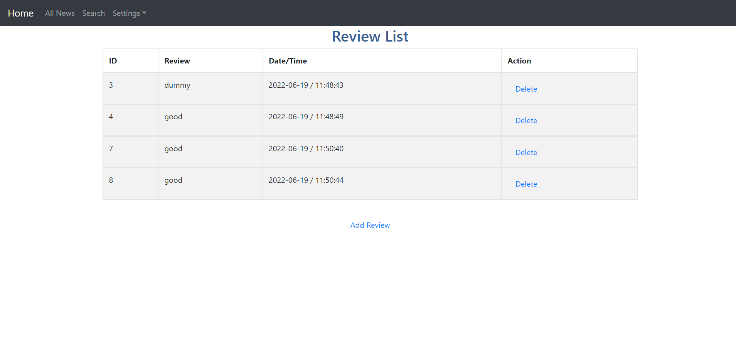
3. Guest User Activities - Predict the sentiment analysis

Slide 13
Thank You!!!

